Slide 1
PTSA Meeting
College and Career Readiness
April 19, 2022
Lake Nona High School Student Services

Slide 2
What is Acceleration?
In addition to scheduling all students in appropriate core courses and elective options of interest, we help to ensure students have at least one opportunity each year to earn an acceleration credit. This helps ensure our students have exposure to rigorous coursework and are college and/or career ready once they graduate Lake Nona HS.
An acceleration credit is earned by passing an AP exam, earning a dual enrollment credit, and/or passing an industry certification exam.

Slide 3
Advanced Placement (AP) at a Glance
•The Advanced Placement Program® (AP) enables willing and academically prepared students to pursue college-level studies while still in high school.
•The program consists of college-level courses developed by the AP Program that high schools can choose to offer, and corresponding exams that are administered once a year.

Slide 4
What are the benefits of AP?
Build skills and confidence
•AP students learn essential time management and study skills needed for college and career success.
•They dig deeper into subjects that interest them and learn to tap their creativity and their problem-solving skills to address course challenges.
Get into college
•Students who take AP courses send a signal to colleges that they’re serious about their education and that they’re willing to challenge themselves with rigorous coursework.
•85% of selective colleges and universities report that a student’s AP experience favorably impacts admission decisions.
•Weighted GPA; A=6.0
Succeed in college
•Research shows that students who receive a score of 3 or higher on AP Exams typically experience greater academic success in college and have higher graduation rates than their non-AP peers.
Save time and money
•Research shows that students who take AP courses and exams are much more likely than their peers to complete a college degree on time—which means they avoid paying for, for example, a fifth year of tuition.
•Most colleges and universities nationwide offer college credit, advanced placement, or both for qualifying AP Exam scores. This can mean:
•Fulfilling graduation requirements early
•Being able to skip introductory courses or required general-education courses

Slide 5
AP Exams
•Each AP course concludes with an AP Exam. These assessments are designed by the same expert committee that designed the course.
•The exams are scored on a scale of 1 to 5 by college and university professors and experienced AP teachers. Many U.S. colleges offer credit for AP Exam scores of 3 or higher.
•AP Exam scores do not calculate as part of the student’s final grade in the course.

Slide 6
AP Course Offerings
Art History | Biology | Calculus AB | Calculus BC
Capstone Research | Capstone Seminar | Chemistry | Computer Science Principles
Computer Science A | English Language and Composition | English Literature and Composition | Environmental Science
European History | French Language and Culture | Human Geography | Macroeconomics
Music Theory | Physics 1 | Physics C: Mechanics | Psychology
Spanish Language and Culture | Spanish Literature and Culture | Statistics | Studio Art: 2-D Design Portfolio
Studio Art: Drawing Portfolio | United States Government and Politics | United States History | World History
Notes:
These are all the AP courses we currently offer. AP courses, as we have discussed are considered college-level courses, and are weighted higher than regular and honors classes. All will have an AP exam at the end of the course. If you pass this exam with a 3 or higher, most universities will accept the credit, which means you would not have to take the class in college. Passing an AP test will also earn you an acceleration credit, which can qualify you for early release/late arrival your senior year.

Slide 7
Dual Enrollment (DE) at a Glance
•The Dual Enrollment program is an opportunity for students to take college courses while in high school
•Can be through Valencia, UCF, UF and/or OTC
•Requires a minimum of a 3.0 HS unweighted GPA and college-ready test scores (PERT, SAT and/or ACT)
•Recommend waiting until Junior Year for most DE Courses; Speak with your counselor if you are interested in this program
•Deadlines are NOT Flexible; Students must advocate for themselves
•Weighted GPA -- A = 6pts

Slide 8
Dual-Enrollment Benefits & Considerations
(on track to graduate with an AA)
Benefits
For in-state institutions, it can shorten the time to complete undergraduate degree.
Students have experience with college scheduling and classes while in high school.
Save money towards earning a degree.
Ability to satisfy high school requirements as well as AA degree requirements.
Considerations
There is no guarantee all credits will count for an AA degree earned while in high school. It is up to the institution to decide how many credits they will accept.
Can cause issues with future employment if the student is too young and has no job experience.
A major must be declared once student starts college. If student is unsure of what they want to study, this can cause issues for them.
Dual Enrollment is NOT a direct connect to any institution. Students must still apply to the college as a first time college student, not a transfer student.

Slide 9
AP Classes vs. Dual Enrollment
AP Classes
Colleges tend to award credit more easily based on AP test scores (typically 3 or higher)
Academically challenging classes
Out-of-state tuitions tend to look more favorably on AP classes because the curriculum is familiar
Helps increase weighted GPA.
No guarantee college credit will be awarded by passing the class, student must achieve the required test score
Dual Enrollment
Students have experience with a college setting while in high school.
Save money towards earning a degree.
Helps increase the weighted GPA.
The student is the only one that can advocate for him or herself. Parents must be “hands off”.
More variety of classes.
Students are able to experience different campuses.

Slide 10
College & Career Readiness Pathways
Agriscience Program (Horticulture)
Collegiate Academy (Dual Enrollment)
Digital Media
Early Childhood Education
Health Science Academy
Law Enforcement
Project Lead the Way (Engineering)

Slide 13
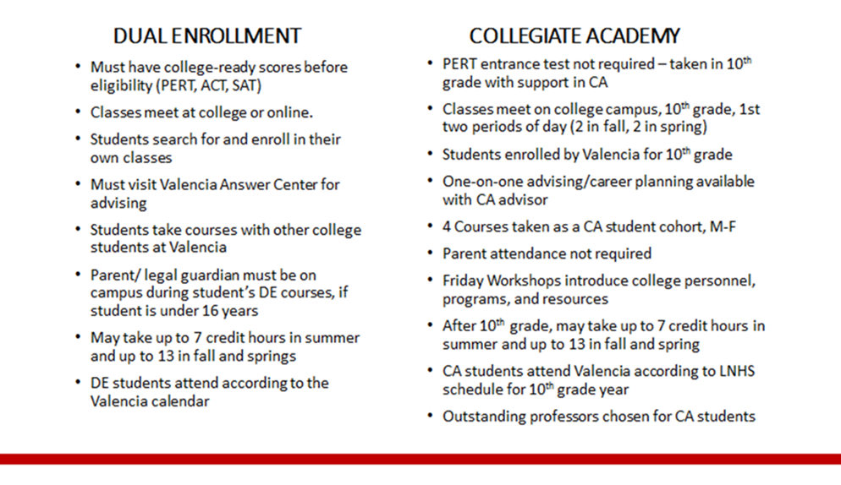
Dual Enrollment vs. Collegiate Academy

Slide 19
Grade Point Average
Only final grades are included in your GPA calculation. For full-year courses, semester grades will calculate a tentative GPA based on semester progress but the final GPA will recalculate for each class at the end of the year once final grades are awarded.
Unweighted | Weighted (Honors) | Weighted (AP & DE)
A = 4 B = 3 C = 2 D = 1 F = 0 | A = 5 B = 4 C = 3 D = 1 F = 0 | A = 6 B = 5 C = 4 D = 1 F = 0

Slide 20
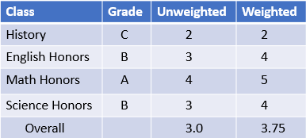
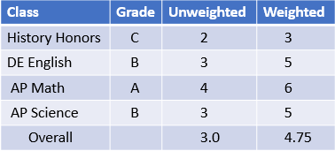
Impact of Grades on GPA
OCPS weights grades as follows:
•Standard courses on a 4 point scale: A = 4, B = 3, C = 2, D = 1, F = 0
•Honors courses on a 5 point scale: A = 5, B = 4, C = 3, D =2, F = 1
•College courses (AP & DE) on a 6 point scale: A = 6, B = 5, C = 4, D = 3, F=2
•OCPS uses weighted GPA for class rank
Postsecondary schools each calculate their admissions GPA differently. While some look at weighted GPAs, some universities and colleges look at unweighted, and some look only at the core classes unweighted. If you meet their minimum GPA, they do consider the types of courses.

Slide 21
The impact of 0 on student grades
Assignment 1 = 80
Assignment 2 = 0
Assignment 3 = 75
Assignment 4 = 60
Assignment 5 = 100
Assignment 6 = 0
Assignment 7 = 79
Assignment 8 = 0
Assignment 9 = 95
Assignment 10= 80
Total Points/# of Assignments
569/10 = 56.9
* This student earned an F for the 9 weeks
Assignment 1 = 80
Assignment 2 = 50
Assignment 3 = 75
Assignment 4 = 60
Assignment 5 = 100
Assignment 6 = 50
Assignment 7 = 79
Assignment 8 = 50
Assignment 9 = 95
Assignment 10= 80
Total Points/# of Assignments
719/10 = 71.9
* This student earned a C for the 9 weeks
Notes:
21

Slide 22
LNHS Curriculum Guide
Students → Student Services → Curriculum Guide

